Slide 1



Hassan Ali Khan
System and Networking Research Lab (SysNet)
LUMS
15030044@lums.edu.pk
1

Slide 2







Internet of Things(IoT)
Components:
2
Notes:
adasdasd

Slide 3
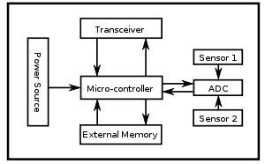
Internet of Things(IoT)
Sensing Node:
3

Slide 4





Internet of Things(IoT)
Applications:
Water usage sensing
Smart meters
Fire sensors
Air conditioning sensing
AT&T - Connected Car
Tesla cars
IoT
Health tracking - JawboneUPS
Fitness Tracker - Fitbit
Smart Watches - iWatchs
Smart waste recycling
Smart street lightning
Smart parking
4

Slide 5
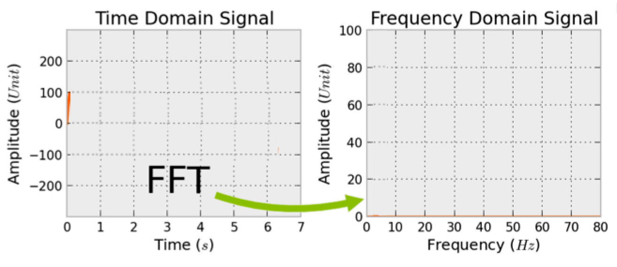
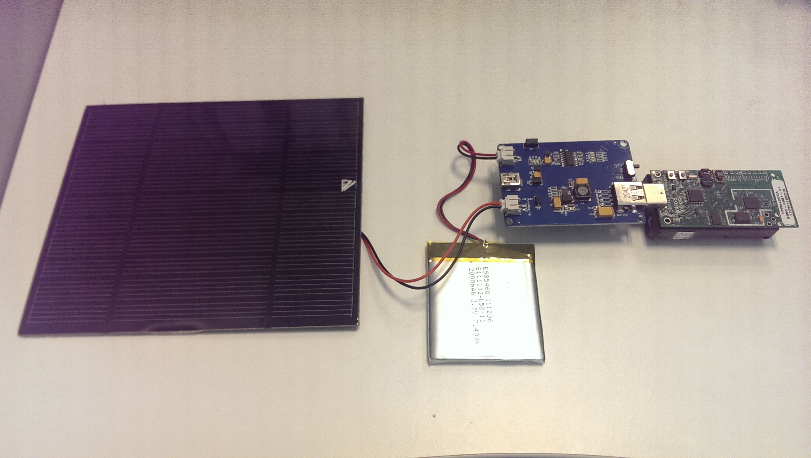

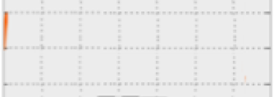
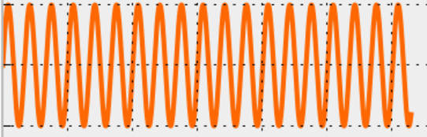





State Retention Issue
Lost
Lost
Telosb (with integrated solar panel for energy harvesting) calculating FFT
Mote’s Battery life cycle
Charging
Running
Dead
Save State
Input Voltage (V)
Operating
Voltage
Times(s)
5

Slide 6




Conventional Solution
Checkpoint whole RAM and registers
Drawback:
Energy Consuming
Time Expensive
For CP consistency
6

Slide 7
Proposed Solution
INCH: Incremental, Near Optimal Checkpointing for Intermittent Computations
TinyOS Components
- Static analysis
nesC compiler
- Instrument memory updating instructions
- Keep record of updated locations
C-code
- Minimum number of writes on CP update
- Least CP overhead
Inch
Instrumentation
Instrumented
C-code
msp430-gcc
Executable
Block Diagram
7

Slide 8
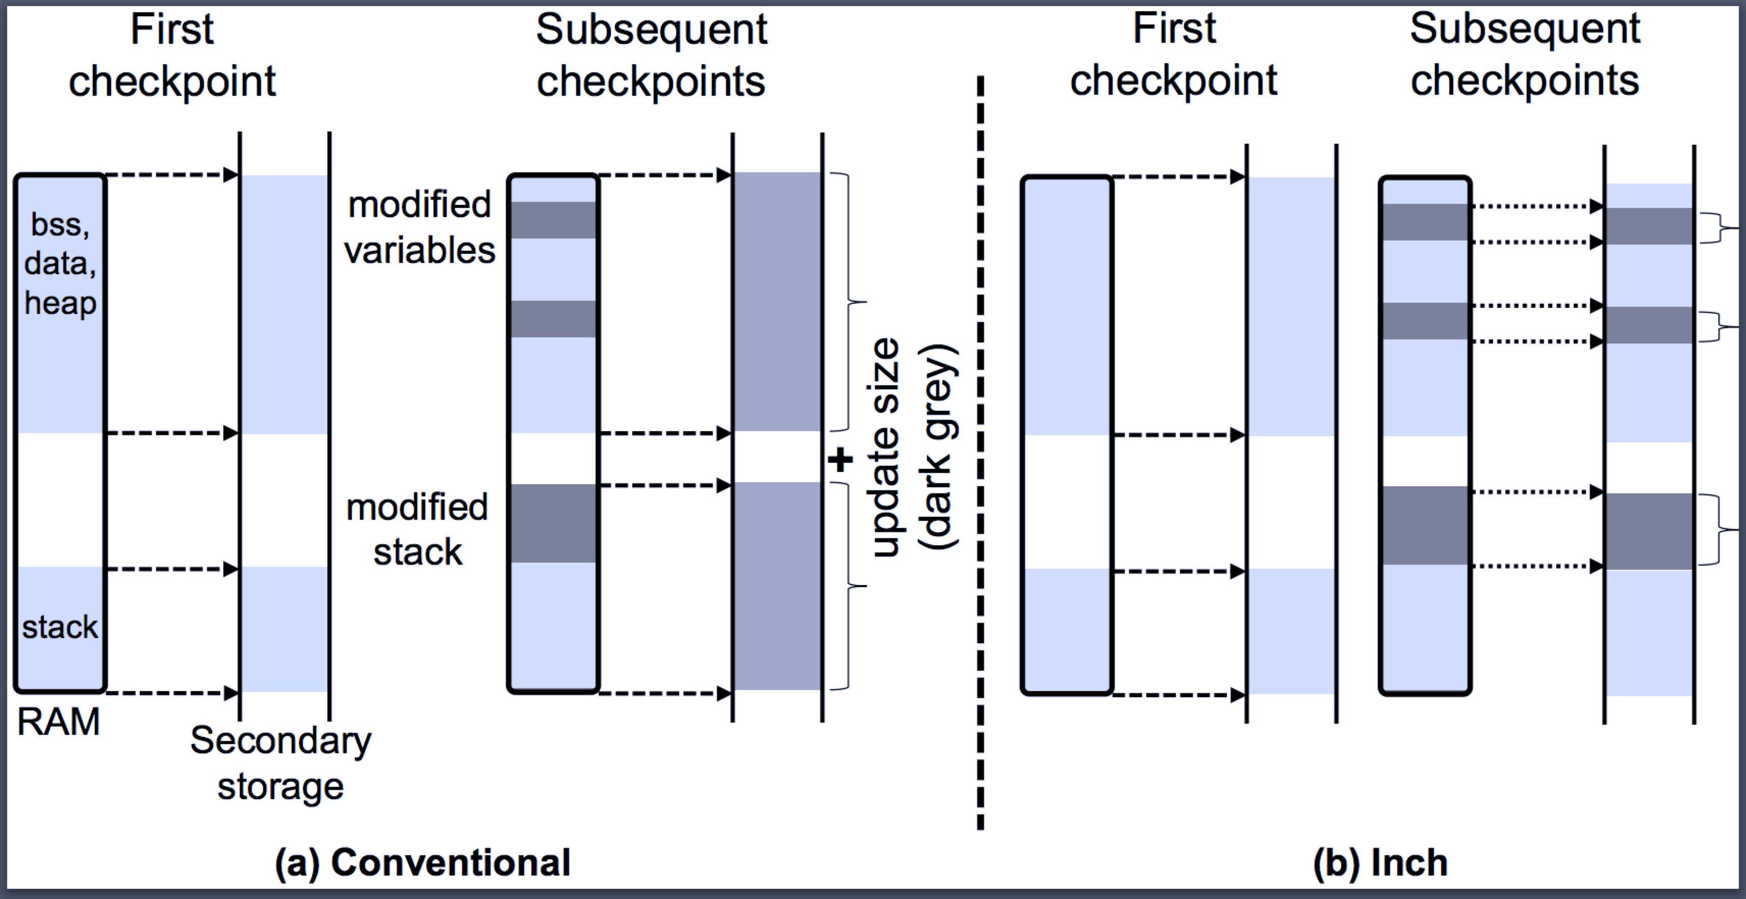
INCH-Contd.
INCH VS Conventional approach
8

Slide 9
INCH-Global Vars. Tracking
Code example:
Code Presented
int a=0,b=0; int main(){ int y=foo(x); if(y<10){ a++; } else{ b=b+1; } …
Code Instrumentation
int a=0,b=0; int main(){ int y=foo(x); if(y<10){ record(&a,sizeof(a)); a++; } else{ record(&b,sizeof(b)); b=b+1; } …
➔
9

Slide 10




INCH-Stack Tracking
INCH VS Conventional approach
3rd Checkpoint
2nd Checkpoint
1st Checkpoint
Stack Segment
Checkpoint
F3
F3
F2
F2
F1
F1
BP
SP
ST
10

Slide 11
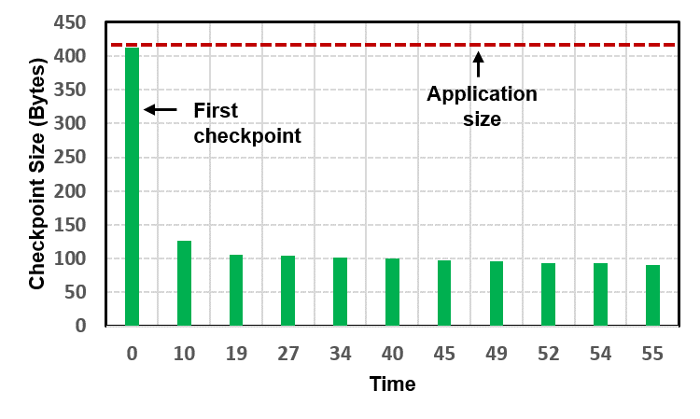
INCH-Initial Results
Radio to counter application:
CP interruption interval = 10s
11
Notes:
Checkpoint size when using an incremental approach (green bars) is significantly less than the complete application size (horizontal dotted line). This graph depicts the results of a simple TinyOS application that displays a counter, received in a packet, on the three LEDs of TelosB. The application is interrupted after every 10 seconds to checkpoint and restore its state.

Slide 12
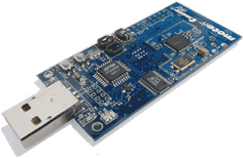




INCH-Evaluation
Evaluation platform:
Test Applications:
Hardware
Software
FFT
Sense
This application repeatedly calculates the FFT on a randomly populated (32 bit) long integer array of size 448 (1792 bytes)
A typical sensing application that randomly (range: 1ms--10ms) samples a sensor, and calculates the average over an array
RSA
25O kbps, High Data Rate Radio
Opensource
MSP430 MC, 10kB RAM
NesC language
USB Interface
Interrupts based OS
Integrated Temp, Light and Humidity Sensors
This application repeatedly computes RSA over a randomly populated character array of size 2400 bytes, 60 bytes at time
Interfaces for routing, sensing, storage etc.
12

Slide 13
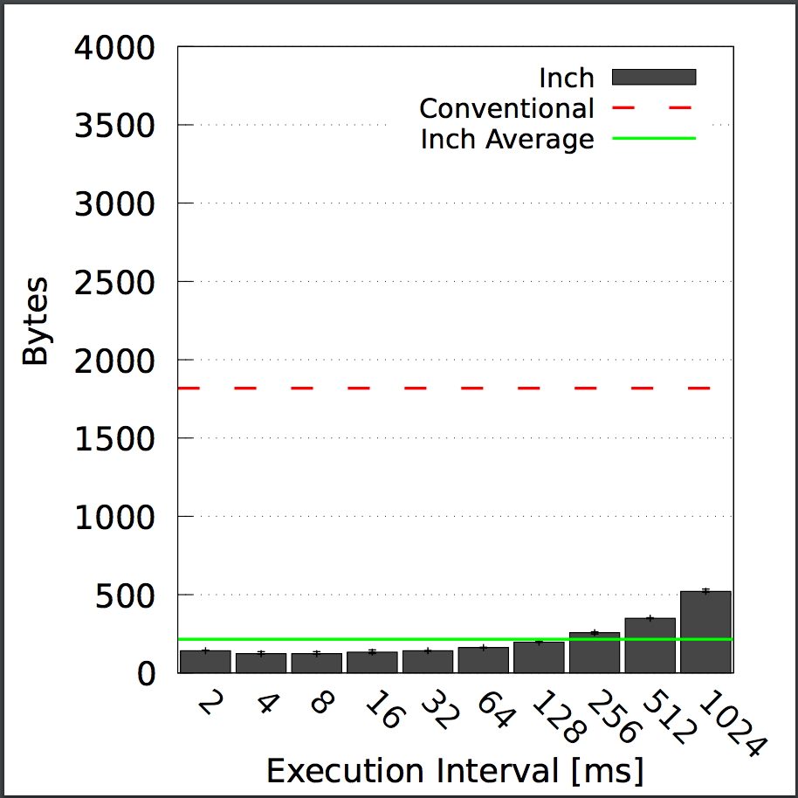
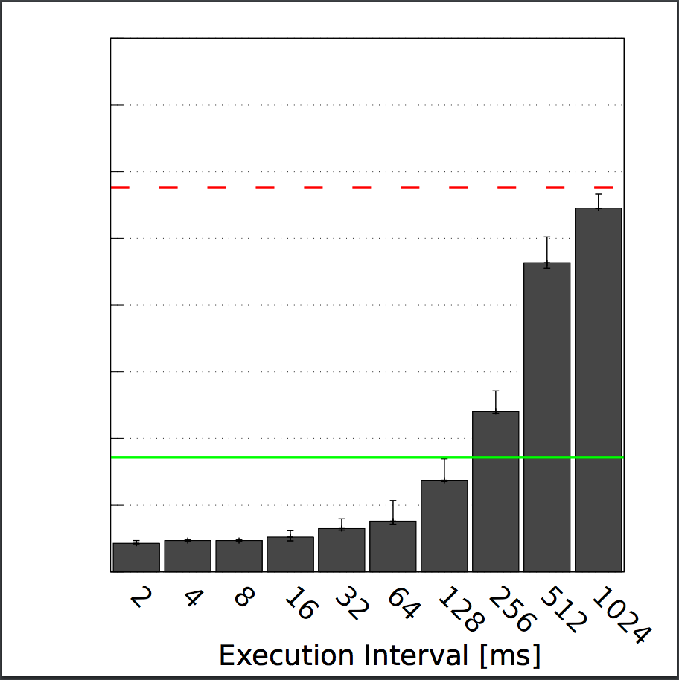
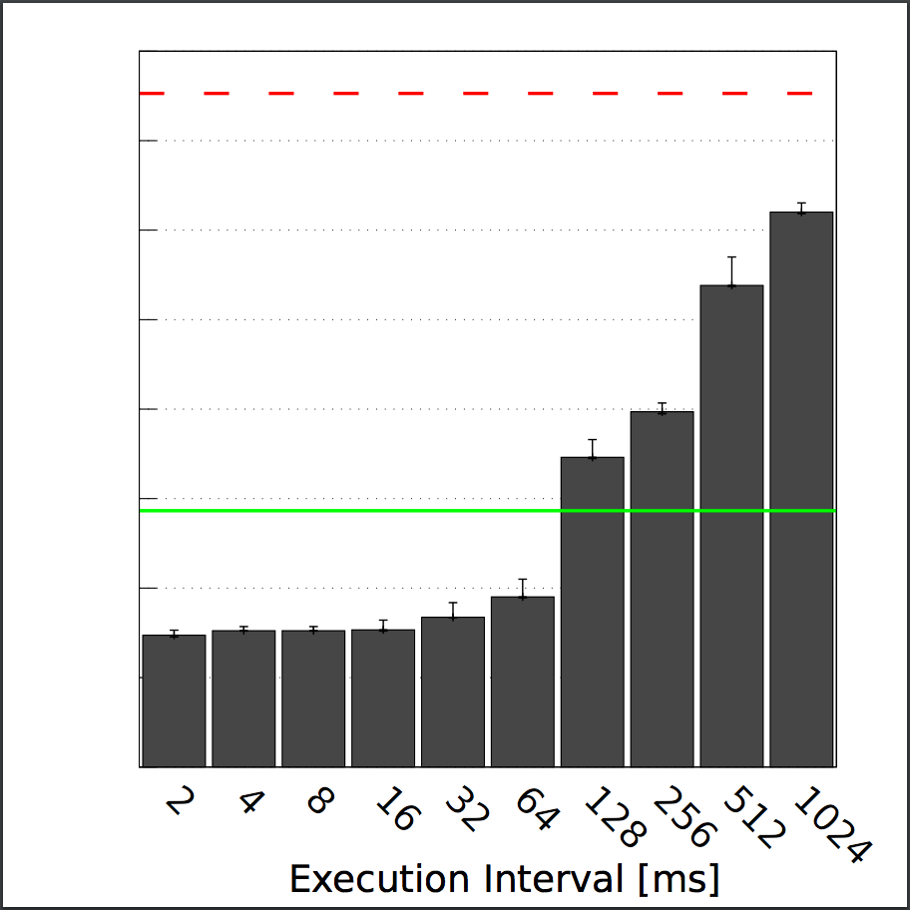
INCH-Evaluation
Checkpoint Size:
Size-Sense
Size-FFT
Size-Size
13

Slide 14
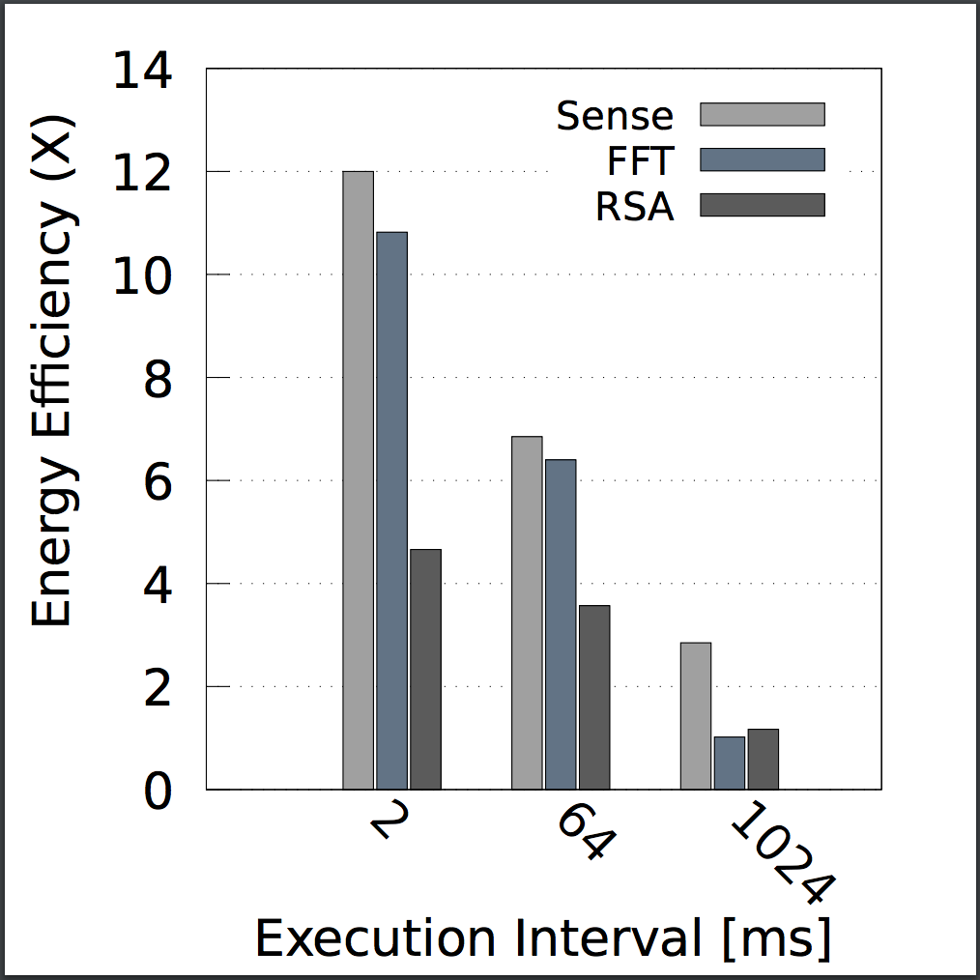
INCH-Evaluation
Energy Efficiency:
14

Slide 15
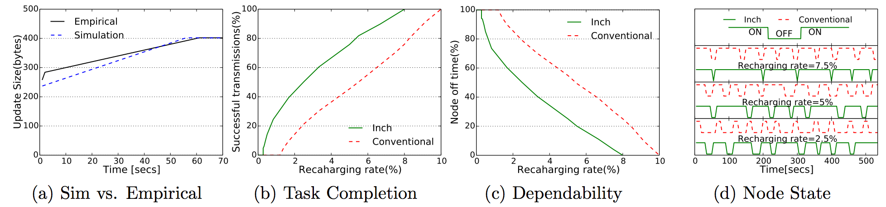
INCH-Evaluation
Simulation Results :
- Latency & Computation overhead
15

Slide 16
INCH-Limitations
Additional computations
Ignores state full peripherals
16

Slide 17
My Role
Interface implementation for INCH
Libraries integration
Generating results on benchmark applications
17

Slide 18

Thank you
18

Slide 19



Related Work
Two classes of solution
1st Class
2nd Class
Examples:
Analysis:
Examples:
-
-
Analysis:
Uses separate memories for normal computations and checkpoint storage
Uses non-volatile storage as their only address space
1: MementOS (ASPLOS’11)
1: Quick Recall(ASPLOS’11)
CP size optimization
Loop-latch
Less data to be written
FRAM for process’ computations
Rewriting
Voltage threshold
Energy(FRAM)>>Energy(RAM)
2: Hibernus(IEEE’15)
Writes only registers during checkpoint
Data inconsistency
CP size optimization
FRAM, Function-return
FRAM
Interrupt for low voltage
No flash erase overhead
Rewriting
No CP affirmation
7

Slide 20
Challenges
Minimize number of writes during checkpoint
Right time to update the checkpoint
8

Slide 21
INCH Contd.
Work flow and Outputs
INCH analyzes the code statistically before execution and add the “tracking” call to the code.
On 1st execution cycle whole RAM in copied on FRAM
In later executions only the modified memory location are recorded for checkpoint update
The number of write operations are reduced due to smaller update size and incremental checkpointing.
Introduces computational overhead of tracking RAM.

Slide 22
INCH- Incremental Checkpointing for Interruptible Computations
Introduction:
Computational state is only changed by a few statements
INCH instrument the source code to record memory locations before the execution of such state-modifying statements.
Offers a better tradeoff between computations and checkpointing overhead.

Slide 23
My Role
Interface implementation
Library integration
Generating results on benchmark applications

Slide 24
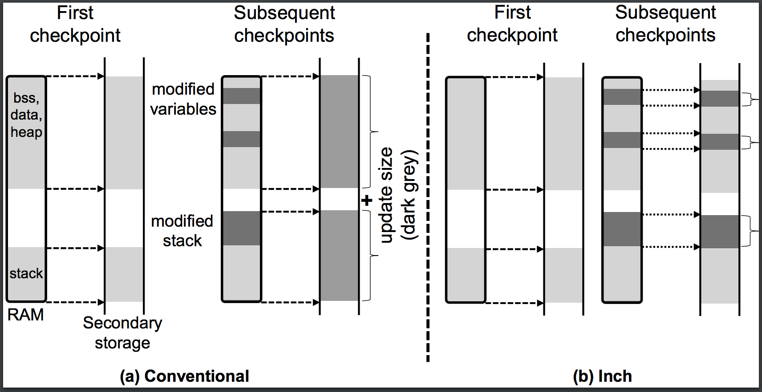
Proposed Approach – INCH Contd

Slide 25
INCH Contd.
Code Presented
int a=0,b=0; int main(){ int y=foo(x); if(y<10){ a++; } else{ b=b+1; } …
Code Instrumentation
int a=0,b=0; int main(){ int y=foo(x); if(y<10){ record(&a,sizeof(a)); a++; } else{ record(&b,sizeof(b)); b=b+1; } …
➔

Slide 26
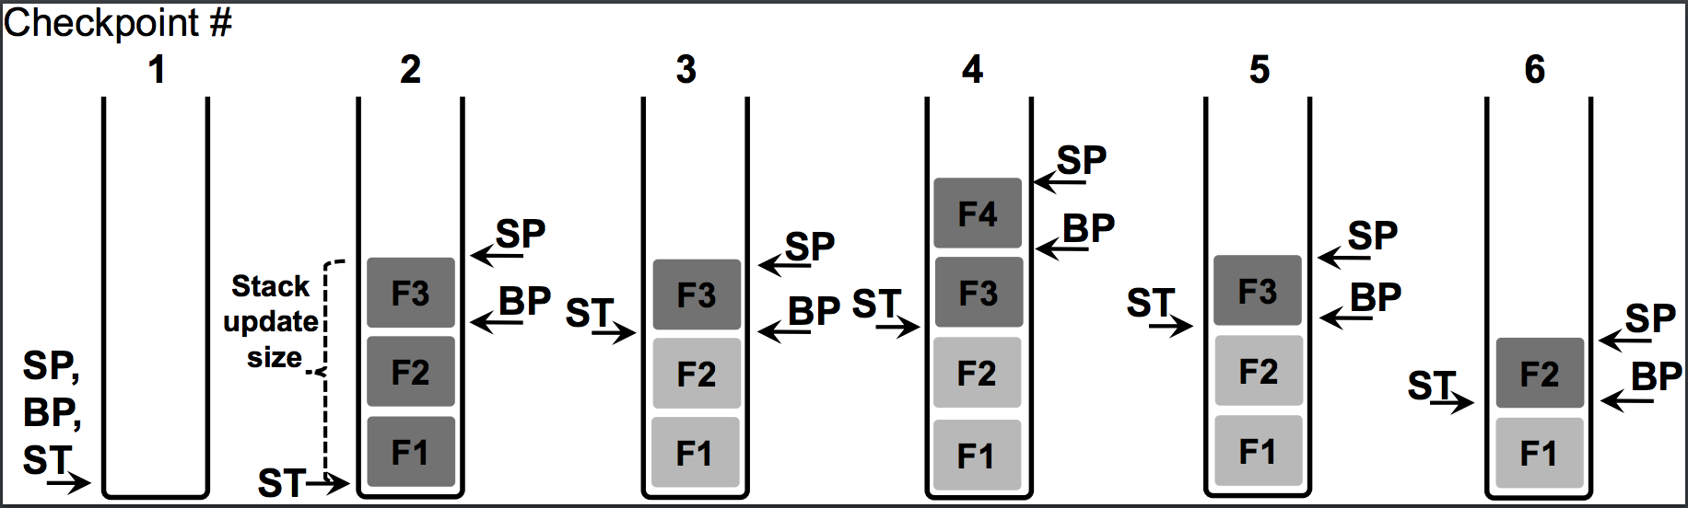
INCH Contd.
Stack Optimization:

Slide 27
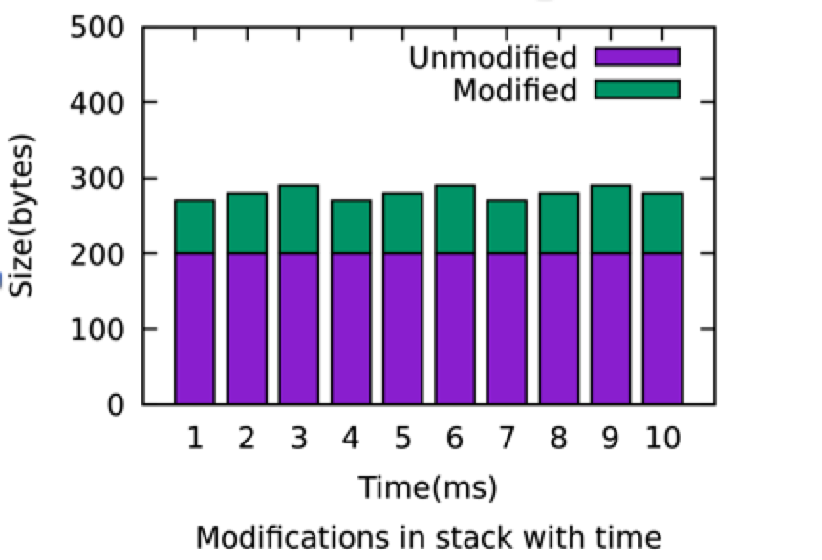
INCH Contd.
Stack Optimization:

Slide 28
INCH-Initial Results
Checkpoint size when using an incremental approach (green bars) is significantly less than the complete application size (horizontal dotted line). This graph depicts the results of a simple TinyOS application that displays a counter, received in a packet, on the three LEDs of TelosB. The application is interrupted after every 10 seconds to checkpoint and restore its state.

Slide 29
INCH - Detailed Results
Test Applications
Sense: A typical sensing application that randomly (range: 1ms--10ms) samples a sensor, and calculates the average over an array
FFT: This application repeatedly calculates the FFT on a randomly populated (32 bit) long integer array of size 448 (1792 bytes)
RSA: This application repeatedly computes RSA over a randomly populated character array of size 2400 bytes, 60 bytes at time

Slide 30
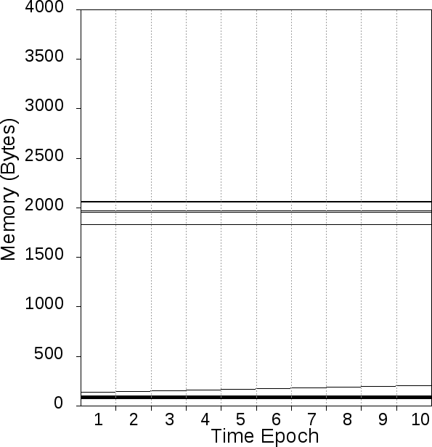
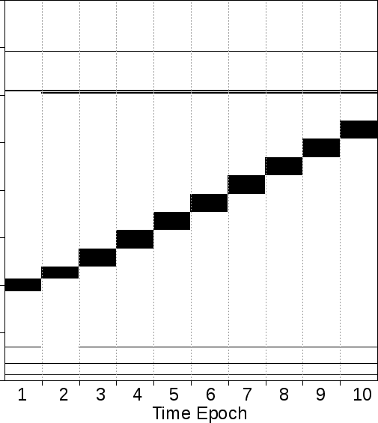
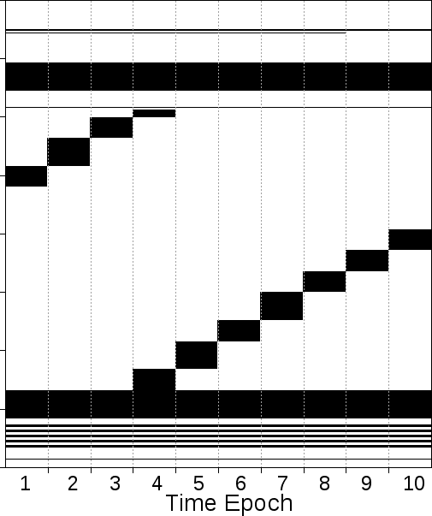
INCH - Detailed Results Contd.
Memory Updates:
Following are the bitmap representations of actual RAM updates over multiple execution,
Bitmap-Sense
Bitmap-FFT
Bitmap-RSA

Slide 31
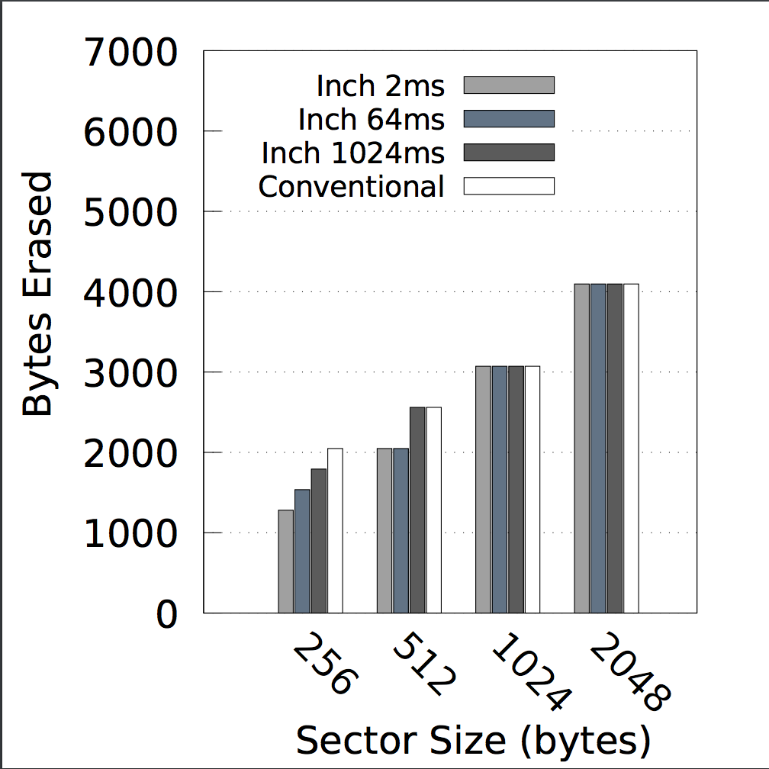
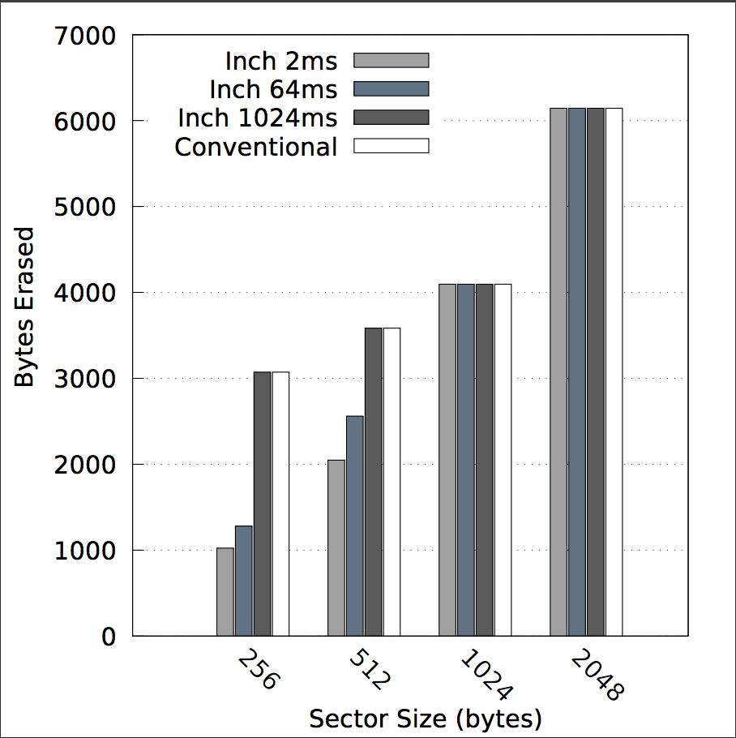
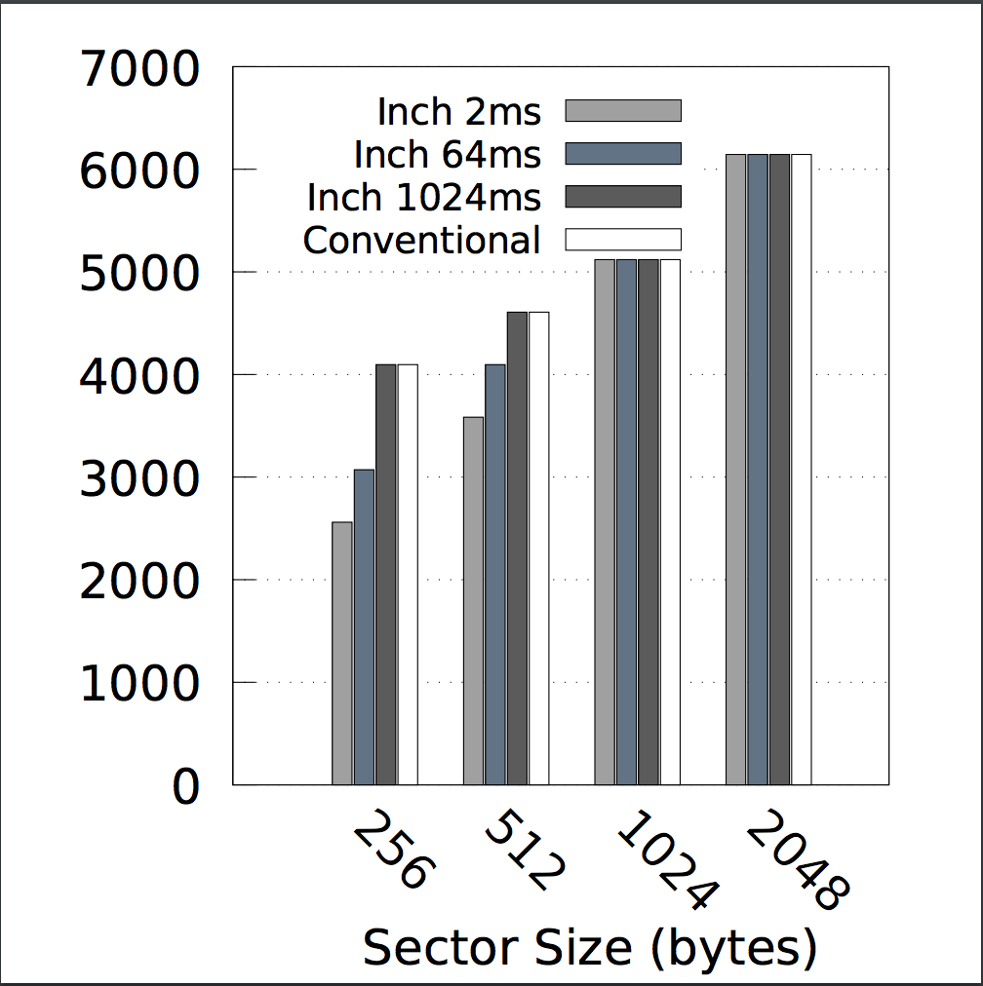
INCH - Detailed Results Contd.
Block Updates:
Blocks-Sense
Blocks-FFT
Blocks-RSA

Slide 32
INCH - Detailed Results Contd.
Checkpoint Size:
Size-Sense
Size-FFT
Size-Size

Slide 33
INCH - Detailed Results Contd.
Energy Efficiency:

Slide 34
Limitations
Time of interruption for checkpoint
Additional computations

Slide 35
Current Research Work
Working to port INCH to other platforms and evaluate another approach for state retention

Slide 36
Future Work
“When to checkpoint” is still unanswered
Explore another optimal solution to the questions mentioned in challenges part.
“Code path to variables binding”

Slide 37
Future Work Contd.
In this approach the static analyzer will find all the possible code paths
Total number of modifiable bytes of global data segment in each code path will be calculated
Data structure for particular code paths will hold a list of all the modified memory addresses in that specific path
A call for routine CheckEnergyLeft(nextCodePath) will be added before the execution of any code path and feasibility of checkpoint will be calculated

Slide 38
Thank you

